Slide 1

Stress Detection In IT Professional by Image Processing and Machine Learning
Date
Names

Slide 2
Content
Abstract.
Introduction.
Problem Statement.
Proposed Solution.
Modules.
System Requirement.
Work completed.
Conclusion.
References.

Slide 3
Abstract
The increasing work pressure in the IT industry leads to stress-related health issues. Early detection of stress can help prevent burnout and improve employee well-being.
This project develops a web-based stress detection system using Machine Learning (ML), Image Processing, and OpenCV.
The system analyzes facial features captured via webcam. The ML model classifies stress levels based on these visual cues and provides real-time feedback.
The goal is to create an AI-powered solution that helps organizations monitor employee stress levels, give recommendation and suggestions, consult doctors, and promote a healthier work environment.

Slide 4
Introduction
IT employees often face long working hours, tight deadlines, and high job demands, leading to increased stress levels.
Chronic stress affects mental and physical health, causing issues like anxiety, depression, and reduced productivity.
Traditional stress assessment methods (self-reports, surveys) are subjective and time-consuming.
A need for real-time, AI-based stress detection to help employees and organizations proactively manage stress.

Slide 5
Introduction
Objective: Develop an AI-driven web application that detects stress in IT employees using Machine Learning, Image Processing, and OpenCV.
The system will analyze facial features from a webcam feed. A trained ML model classifies stress levels and provides real-time feedback. Helps organizations track employee well-being and take preventive actions.
Other features: Q&A session, Chatbot for mental health, Suggestions, Doctor Consultations.

Slide 6
Problem Statement
Need an easy and real-time stress detection and mental health management platform with all these proposes feature to make stress screening simpler and easier.
Need to develop and train machine learning algorithm to detect stress levels from user’s webcam feed in real-time.
Frontend web app should be developed in HTML-CSS to incorporate pages and features.
Features such as Q&A session, Mental health chatbot, Doctor Consultations, etc should also be there in the web app.

Slide 7
Proposed Solution
Proposed solution is an HTML-based web app with a well-trained Machine Learning Model at the backend to detect stress from face accurately.
Images for various facial expressions such as happy, sad, tensed, etc will be collected and cleaned to train the model.
Sources and repositories like www.kaggle.com are used for image data collection.
The image dataset is used to train the ML algorithm called CNN (Convolutional Neural network).
Developed CNN algorithm in Tensorflow python library.
Train the algorithm with the image dataset collected - Save the trained model.
Develop frontend HTML pages and integrate the model using python Flask backend.

Slide 8
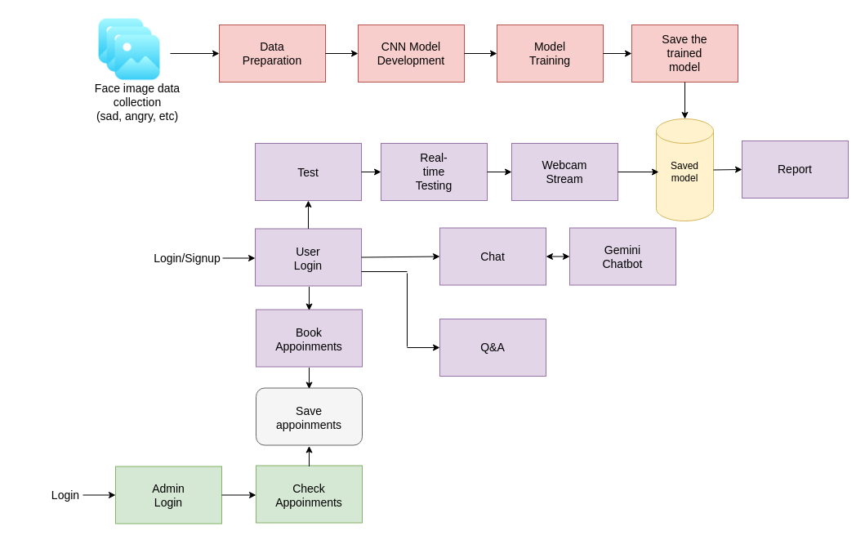
Proposed Solution - DFD

Slide 9
Proposed Solution
the frontend pages are developed in HTML and CSS.
All the features are added to the HTML pages.
Webcam feed from frontend is connected to the trained model at the backend.
Chatbot is developed in Gemini API.

Slide 10
Modules
Admin Module: To check and analyze doctor bookings.
User Login Module: For user to signup/login/match credentials.
Q&A Module: To see frequently asked questions.
Chatbot Module: For chatting with mental health chatbot.
Consultation Module: For the users to book doctors.
Stress Test Module: To test stress in real-time from webcam live feed.

Slide 11
System Requirement
Hardware Requirement: Basic System with i5 or higher processor.
Software Requirement:
Python development platform: Google Colab IDE
ML and backend language: Python 3.9
Frontend language: HTML and CSS.
And python libraries such as Tensorflow and OpenCV.

Slide 12
Work completed
Data collection and analysis.
Image data of different emotions are collected and organized to train the CNN.
collected from
https://www.kaggle.com/datasets/jonathanoheix/face-expression-recognition-dataset
Images are organized into folders - [Angry, Disgusted, Fearful, Happy, Neutral, Sad, Surprised]
angry = 2993 images disgust = 436 images fear = 4103 images
happy = 7164 neutral = 4982 sad = 4938 surprised = 3205

Slide 13
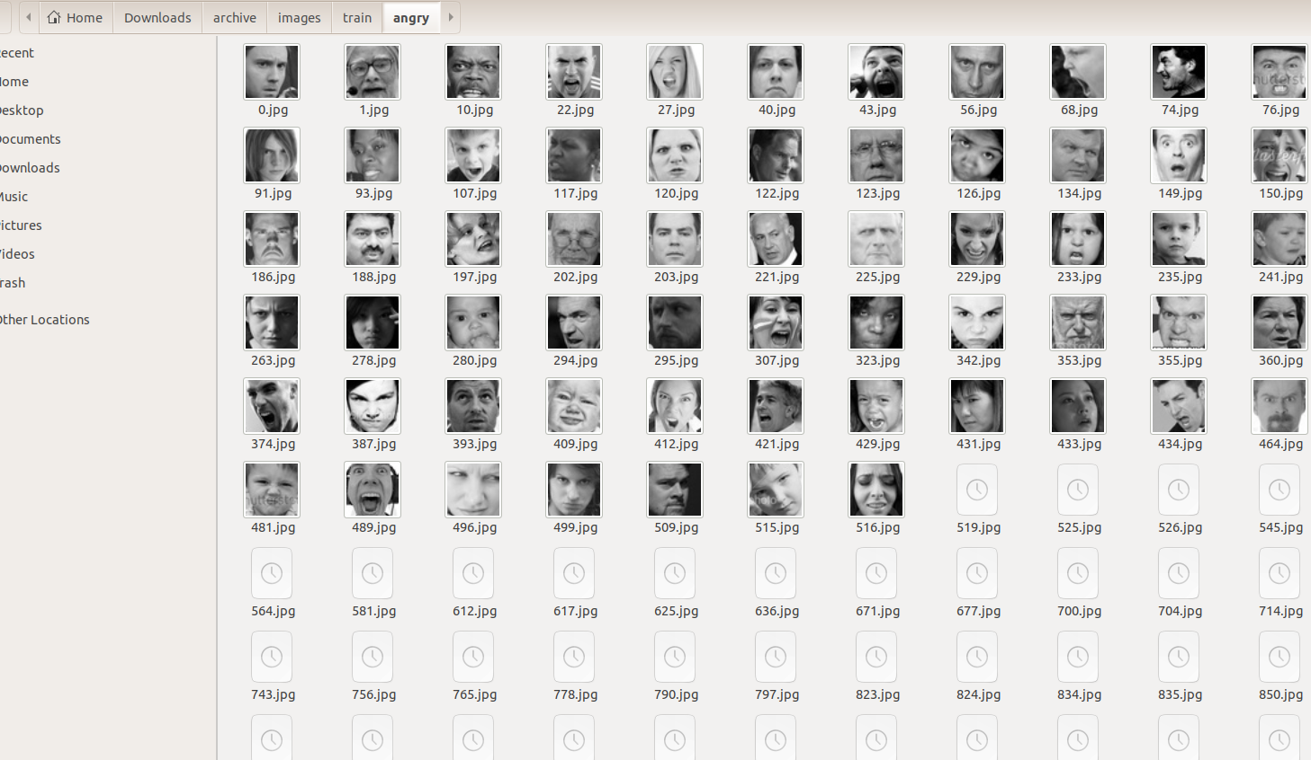
Work completed
image dataset

Slide 14
Work completed
CNN model:
CNN (Convolutional Neural Network) - mathematical operation that has the ability to learn what is in an image.
CNN runs through the nook and corner of an input image and learns low level features like pixels and high level features like edges, curves, etc.
After training, CNN can be used for automatic recognition (here, emotion)
Developed CNN in python using Tensorflow library.

Slide 15
Work completed
CNN model:

Slide 16
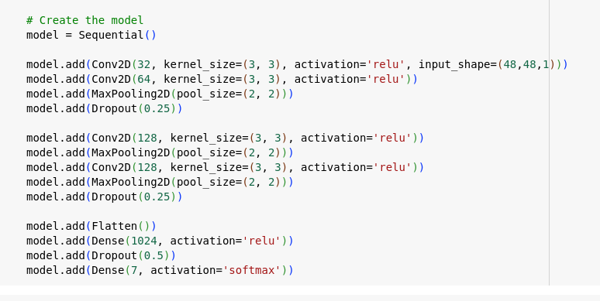
Work completed
CNN model details.
Used Convolutional layers. (Conv)
Used multiple layers.
First layer has 32 convolutions.
Then 64, 128, 128, 1024, and 7.
Trained it for 100 repetitions to get
97.10 % accuracy.
saved the trained CNN algorithm a .h5 file to be used in web app backend.

Slide 17
Work completed
Test the model using images.
choose an image with person and emotion in it.
applied ‘’haar cascade’’ template for detecting and cropping face from the image.
apply this extracted face to our trained model.
Get model output and display.

Slide 18
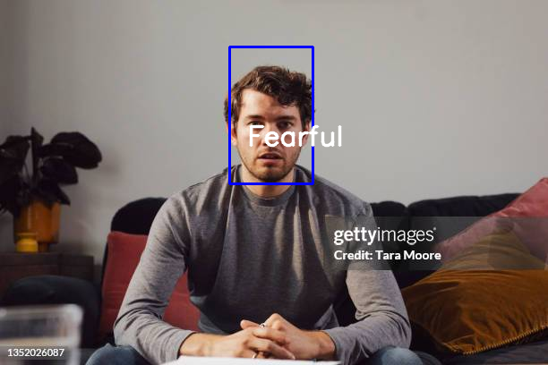
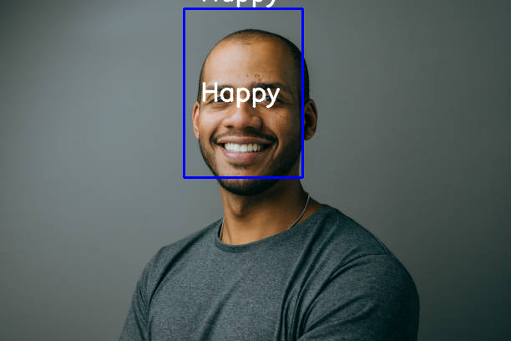
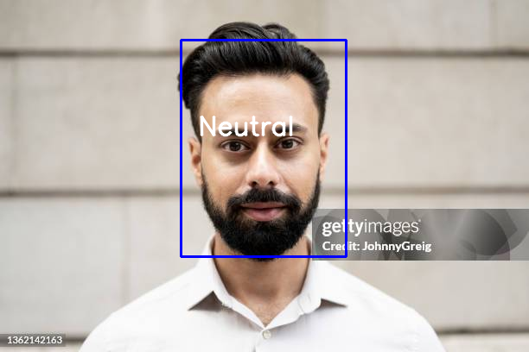
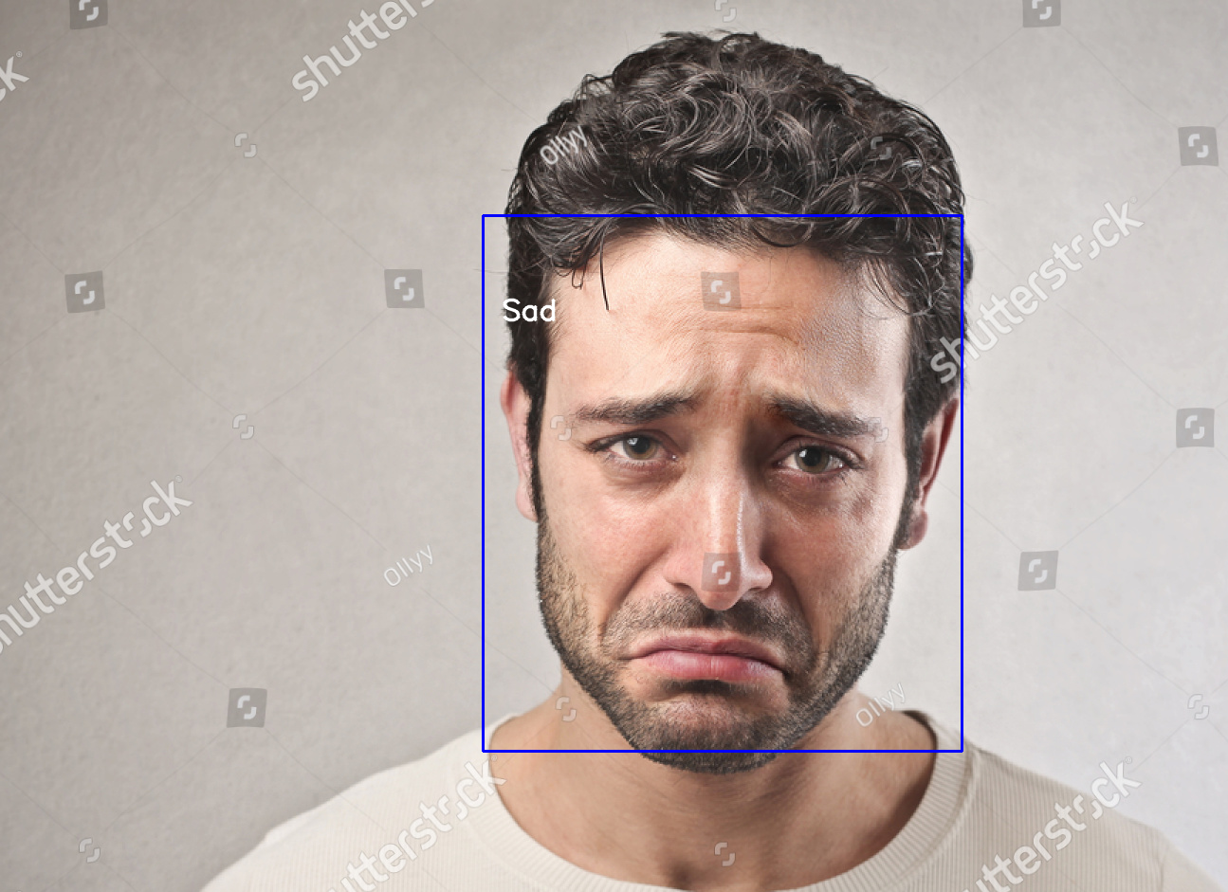
Work completed

Slide 19
Work completed
Develop the frontend
Pages are designed using HTML and CSS.
HTML - for layout, design, buttons, etc.
CSS - for color shades, styles, font, etc.
HTML functions used: <button> , <field> , <url_for>
Pages:
Landing page.
Admin page.
User page.
Login page.
Signup page.
Login failed page.
Signup success page.
Home page.
Consultation page.
Test page.
Q&A page.
About page.
Chatbot page.

Slide 20
Work completed
Integrate and run the final web app
The frontend and backend are connected using Python Flask.
Flask functions like ‘@route’ is used to navigate pages to pages.
frames are extracted and send to the frontend using OpenCV library.
these frames are sent to the trained CNN model too.

Slide 21
Work completed
Pages- screenshot
Landing page.

Slide 22
Work completed
Pages- screenshot
2. Home page.

Slide 23
Work completed
Pages- screenshot
3. Test page.

Slide 24
Conclusion
IT employees face high stress levels due to long work hours, deadlines, and continuous screen exposure. Traditional stress assessment methods are subjective, slow, and ineffective for real-time monitoring.
Developed a web-based stress detection system using Machine Learning, OpenCV, and Image Processing. The system analyzes facial features from a webcam feed and give real-time result.
Features like Chatbot, Q&A, etc are also added.
Future scope:
Enhancing accuracy with multi-modal stress detection (heart rate, voice analysis, etc.)
Deploying as a mobile app for better accessibility.
Partnering with corporates and wellness programs for large-scale adoption

Slide 25
References
A. Jaiswal, A. Krishnama Raju and S. Deb, "Facial Emotion Detection Using Deep Learning," 2020 International Conference for Emerging Technology (INCET), Belgaum, India, 2020, pp. 1-5, doi: 10.1109/INCET49848.2020.9154121.
S. Pandey, S. Handoo and Yogesh, "Facial Emotion Recognition using Deep Learning," 2022 International Mobile and Embedded Technology Conference (MECON), Noida, India, 2022, pp. 248-252, doi: 10.1109/MECON53876.2022.9752189.
H. Chouhayebi, J. Riffi, M. A. Mahraz, A. Yahyaouy and H. Tairi, "Facial expression recognition Using Machine Learning," 2021 Fifth International Conference On Intelligent Computing in Data Sciences (ICDS), Fez, Morocco, 2021, pp. 1-6, doi: 10.1109/ICDS53782.2021.9626709.
https://scholarworks.sjsu.edu/cgi/viewcontent.cgi?article=1643&context=etd_projects
https://www.geeksforgeeks.org/python-haar-cascades-for-object-detection/
https://github.com/opencv/opencv/tree/master/data/haarcascades
Pandey, Amit & Gupta, Aman & Shyam, Radhey. (2022). FACIAL EMOTION DETECTION AND RECOGNITION. 7. 176-179. 10.33564/IJEAST.2022.v07i01.027.
Shehu, Harisu Abdullahi & Sharif, Md. Haidar & Uyaver, Sahin. (2020). Facial expression recognition using deep learning. AIP Conference Proceedings. 2334. 10.1063/5.0042221.

Slide 26

Thank you!
PAGE NUMBER

